Slide 1

Principles of
Operating System
File System Interface

Slide 2


Roadmap
File Concept
Access Methods
Directory Structure
File System Mounting
File Sharing
Protection

Slide 3
File Concept
A file is a named collection of related information that recorded on secondary storage.
  From a user’s perspective, a file is the smallest allotment storage.
Files represent:
  Data
    numeric
    character
    binary
  Program

Slide 4
File Structure
Many different types of information may be stored in a file, according to which a file has a certain defined structure
  Text file: a sequence of characters organized into lines.
  Source file: a sequence of subroutines and functions, each of which is further organized as declarations followed by executable statements.
  Object file: a sequence of bytes organized into blocks understandable by the system’s linker.
  Executable file: a series of code sections that the loader can bring into memory and execute.

Slide 5
File Attributes
A file typically consist of:
  Name: only information kept in human-readable form
  Identifier: unique tag, identifies the file
  Type: needed for systems that support different types
  Location: pointer to file location on device
  Size: current file size
  Protection: controls who can do reading, writing, executing
  Time, date, and user identification: data for protection, security, and usage monitoring
Information about files are kept in the directory structure, which is maintained on the disk.

Slide 6
File Operations
A file is an abstract data type. To define a file properly, we need to consider the operations that can be performed on files.
  Create: find space and make an entry for the file
  Write: keep and update the write pointer
  Read: keep and update the read pointer
  File seek: reposition within file
  Delete: release space and erase the directory entry
  Truncate: allows all attributes to remain unchanged except for file length.

Slide 7
File Operations (cont.)
Open(F_{i})
  search the directory structure on disk for entry F_{i}
  and move the content of entry to memory
Close(F_{i})
  move the content of entry F_{i} in memory to directory structure on disk

Slide 8
Open Files
Several pieces of data are needed to manage open files:
  File pointer: pointer to last read/write location, per process that has the file open
  File-open count: counter of number of times a file is open – to allow removal of data from open-file table when last processes closes it
  Disk location of the file: cache of data access information
  Access rights: per-process access mode information

Slide 9

File Types – Name, Extension

Slide 10
Roadmap
File Concept
Access Methods
Directory Structure
File System Mounting
File Sharing
Protection

Slide 11

Access Methods – Sequential Access
Sequential Access: information in the file is processed in order, one record after another

Slide 12
Access Method – Direct Access
Direct Access: a file is made up of fixed-length logical records that allow programs to read and write records rapidly in no particular order.
Direct access are of great use for immediate access to large amounts of information.
  Databases are often of this type.

Slide 13
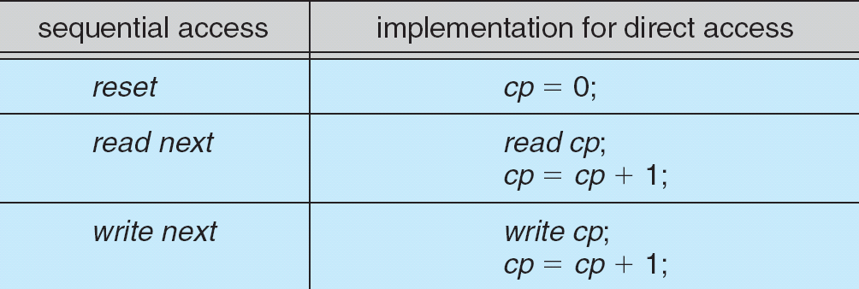
Simulation of Sequential Access on a Direct-access File

Slide 14

Other Methods
Other access methods can be built on top of a direct-access method.
  These methods generally involve the construction of an index for the file.
  The index contains pointers to the various blocks.

Slide 15
Roadmap
File Concept
Access Methods
Directory Structure
File System Mounting
File Sharing
Protection

Slide 16
Directory Structure
A collection of nodes containing information about all files
Directory
Files
F 1
F 2
F 3
F 4
F n
Both the directory structure and the files reside on disk
Backups of these two structures are kept on tapes

Slide 17

A Typical File-system Organization

Slide 18
Operations Performed on Directory
Search for a file
Create a file
Delete a file
List a directory
Rename a file
Traverse the file system

Slide 19
Organize the Directory (Logically) to Obtain
Efficiency: locating a file quickly
Naming: convenient to users
  Two users can have same name for different files
  The same file can have several different names
Grouping: logical grouping of files by properties, (e.g., all Java programs, all games, …)

Slide 20
Logical Structure of A Directory
The most common schemes for defining logical structure of a directory are:
  Single-Level Directory
  Two-Level Directory
  Tree-Structured Directory
  Acyclic-Graph Directory
  General Graph Directory

Slide 21

Single-Level Directory
A single directory for all users
  Easy to support and understand
It has significant limitations, since all files must have unique names in the same directory.

Slide 22

Two-Level Directory
Separate directory for each user
  When a user refers to a particular file, only his own UFD is searched.
  Different users may have files with the same name.
  Difficult to cooperate on some task and to access one another’s files between users.

Slide 23

Tree-Structured Directories
The most common directory structure.
  The tree has a root directory
  Every file in the system has a unique path name
  A path name is the path from the root, through all the subdirectories, to specified file.

Slide 24

Acyclic-Graph Directories
Have shared subdirectories and files

Slide 25

General Graph Directory

Slide 26
General Graph Directory (Cont.)
How do we guarantee no cycles?
  Allow only links to file not subdirectories
  Garbage collection
  Every time a new link is added use a cycle detection algorithm to determine whether it is OK

Slide 27
Roadmap
File Concept
Access Methods
Directory Structure
File System Mounting
File Sharing
Protection

Slide 28
File System Mounting
A file system must be mounted before it can be accessed
A unmounted file system is mounted at a mount point
  Typically, a mount point is an empty directory at which the mounted file system will be attached.

Slide 29

(a) Existing. (b) Unmounted Partition

Slide 30
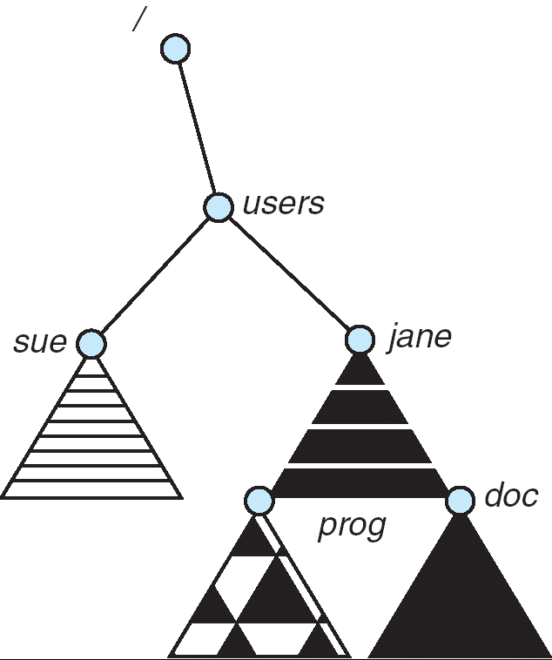
Mount Point

Slide 31
Roadmap
File Concept
Access Methods
Directory Structure
File System Mounting
File Sharing
Protection

Slide 32
File Sharing
Sharing of files on multi-user systems is desirable
Sharing may be done through a protection scheme
On distributed systems, files may be shared across a network
File sharing over the network
  FTP
  WWW
  NFS(Network File System)

Slide 33
File Sharing – Multiple Users
Most systems have evolved to the concepts of file/directory owner and group
  User IDs identify users, allowing permissions and protections to be per-user
  Group IDs allow users to be in groups, permitting group access rights

Slide 34
File Sharing – Remote File Systems
Uses networking to allow file system access between systems
  Manually via programs like FTP
  Automatically, seamlessly using distributed file systems
  Semi automatically via the world wide web

Slide 35
File Sharing – Client Server Model
Client-server model allows clients to mount remote file systems from servers
  Server can serve multiple clients
  Client and user-on-client identification is insecure or complicated
  NFS is standard UNIX client-server file sharing protocol
  CIFS is standard Windows protocol
  Standard operating system file calls are translated into remote calls

Slide 36
File Sharing – Distributed System
Distributed Information Systems (distributed naming services) such as LDAP, DNS, NIS implement unified access to information needed for remote computing

Slide 37
Roadmap
File Concept
Access Methods
Directory Structure
File System Mounting
File Sharing
Protection

Slide 38
Protection
File owner/creator should be able to control:
  what can be done
  by whom
Types of access
  Read, Write, Execute, Append, Delete, List
The most common approach to the protection problem is to make access dependent on the identity of the user.
  Various users may need different types of access to a file or directory.

Slide 39
Keystone
Three access methods
Common directory structure

Slide 40
Principles of
Operating System
End of File System Interface

